Slide 1
Predicting the Outcome of Term Deposit by Customers Using Machine Learning
By
Rajiv Puli

Slide 2

INTRODUCTION
1
Borrowing or attracting public savings into banks is one way financial institutions generate revenue.
The bank invests the client’s long term deposits into other sectors which brings better returns, where some is paid to the customers.
When a customer makes a fixed-term deposit, the company earns more than a savings account because the customer is not allowed to withdraw funds prior to maturity unless the bank is compensated.
The classification goal is to predict if the client will subscribe a term deposit (variable y).

Slide 3

DATASET
2
The data is related with direct marketing campaigns (phone calls) of a Portuguese banking institution.
The marketing campaigns were based on phone calls.
The Dataset is obtained from UCI Machine Learning Repository
There are 17 columns and 45,211 rows in the dataset.
The dataset size is 10 MB.

Slide 4


DATA PREPROCESSING (1)
3
Jupyter Notebook
Used Pandas Library for data cleaning
There are no missing values in dataset
Replaced values in columns Default, Housing, Loan, and Y.
Replaced values of mentioned columns from 'No' to '0' and 'Yes' to '1'

Slide 5
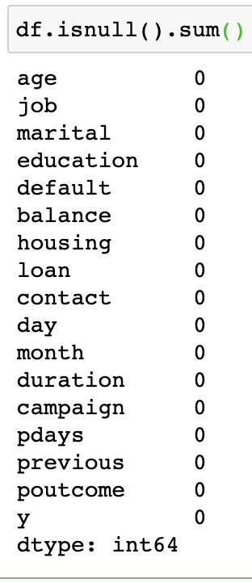
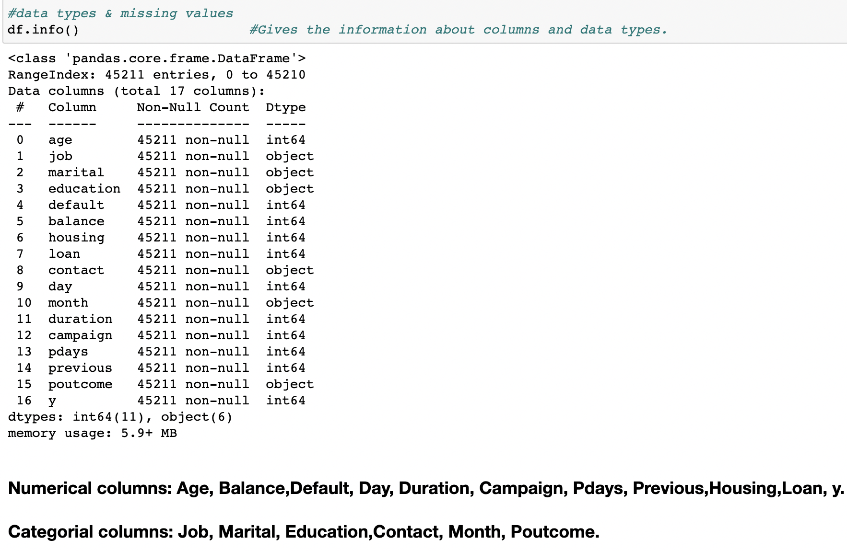
DATA PREPROCESSING (2)
4

Slide 6
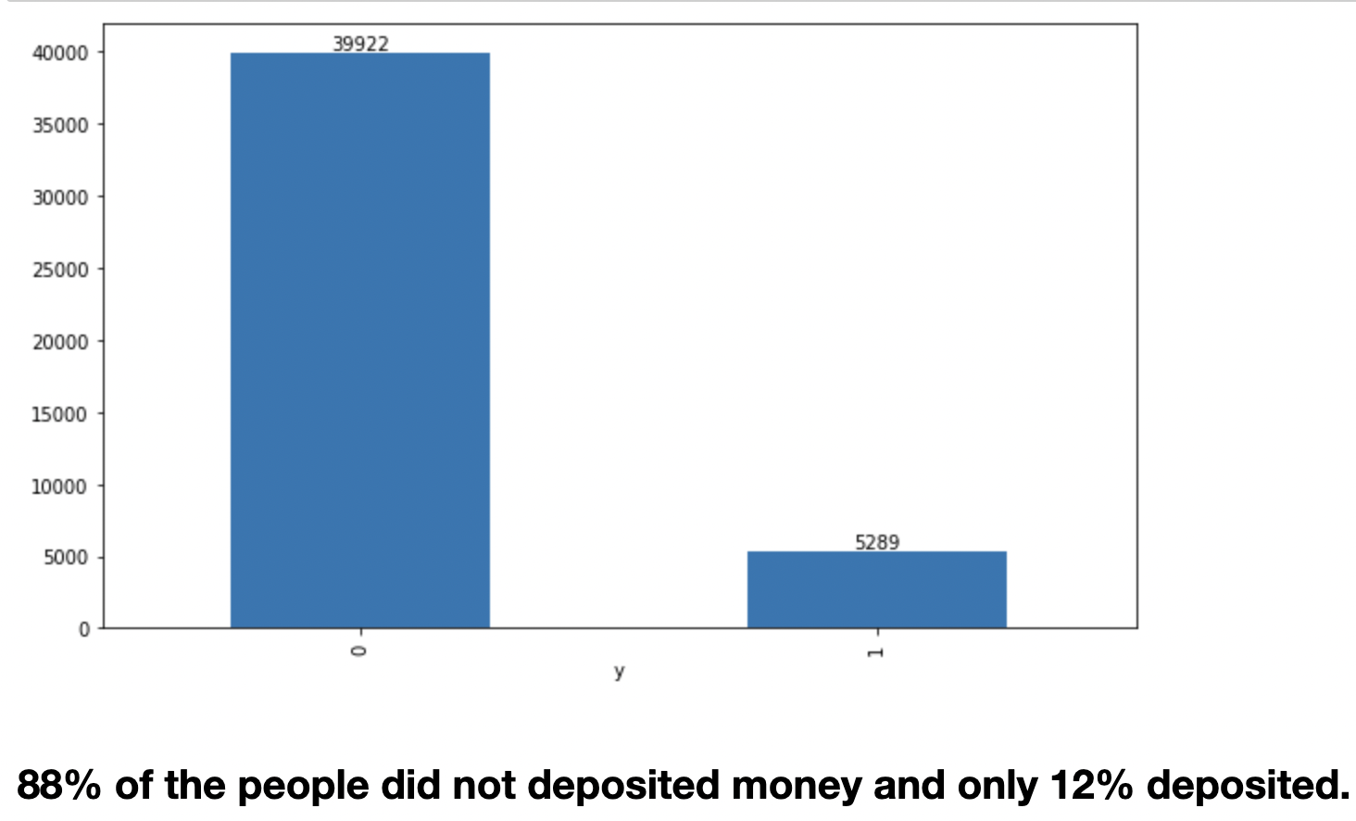
DESCRIPTIVE ANALYSIS
5
Fig 1: Bar Graph of Term Deposit
Percent of customers made Term deposit:

Slide 7
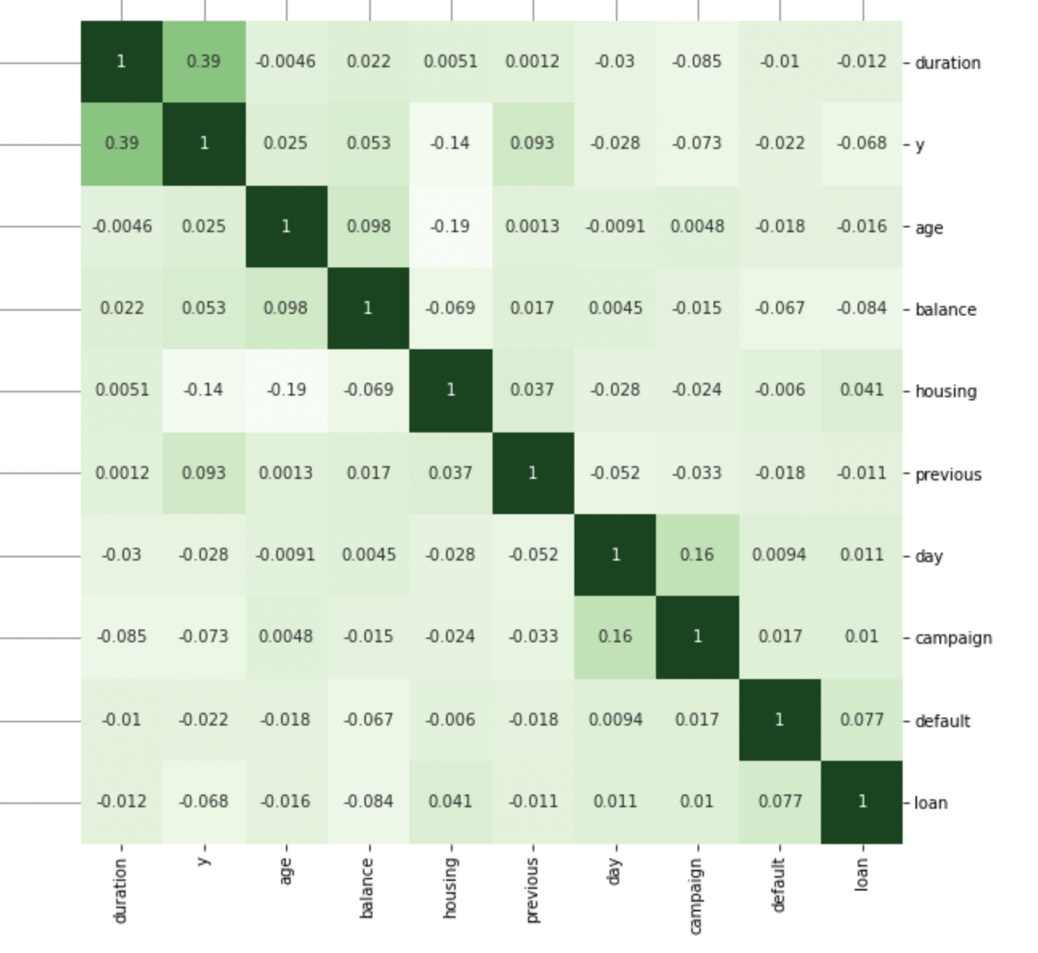
HEAT MAP
6
Fig 2: Heat Map

Slide 8
CORRELATION ANALYSIS
7
Positive Correlation:
There is positive correlation between the 'Duration' column and 'Y' column.

Slide 9
MODEL SELECTION
8
Decision Tree Classification
KNN
Random Forest Classification
Support Vector Machine
XG Boost
Naive Bayes
Logistic Regression

Slide 10
PYTHON LIBRARIES USED
9
​SK Learn
MatplotLib
Pandas
Numpy

Slide 11
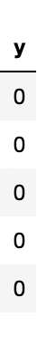
TARGET VARIABLE
10
The Target Variable is ‘Y’ column in the dataset
The column is labeled with ‘0’ and ‘1’
The ‘0’ label means the customer did not subscribed for term deposit
The ‘1’ label means the customer made term deposit

Slide 12
INPUT FEATURES
11
There are 10 features
Default
Loan
Housing
Campaign
Previous
Day
Age
Balance
Duration

Slide 13
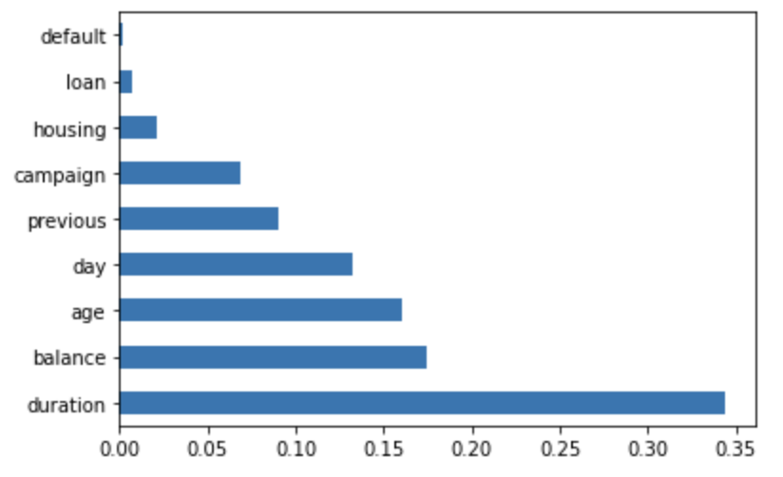
FEATURE SELECTION
12
Fig 3: Feature Importance Bar Graph
The Feature Engineering is performed
The ExtraTreeClassifier() method is used
Removed 5 unimportant features manually
Used 5 important features to build model
But the model performance has not improved

Slide 14
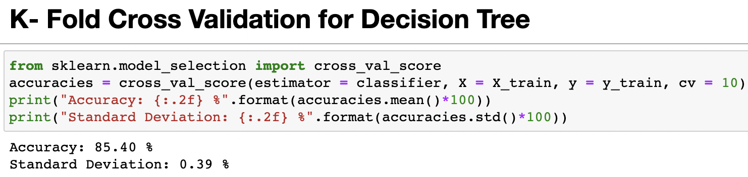
PERFORMED K-FOLD CROSS VALIDATION
13
The K-Fold Cross validation is performed for every model
For the Base Model Decision Tree the cross validation is performed
It increased the model accuracy by .20%

Slide 15
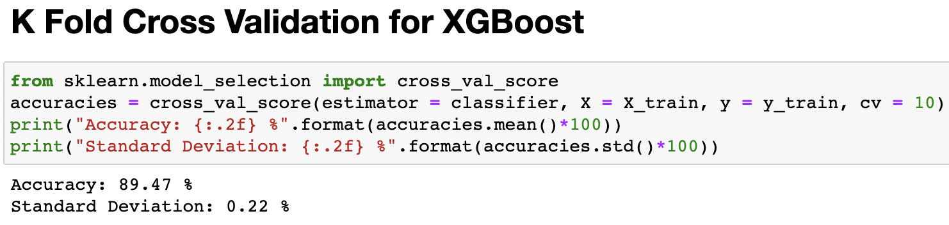
K-FOLD CROSS VALIDATION FOR XGBOOST
14
For the Final Model XGBoost the cross validation is performed
It increased the model accuracy by .30%

Slide 16
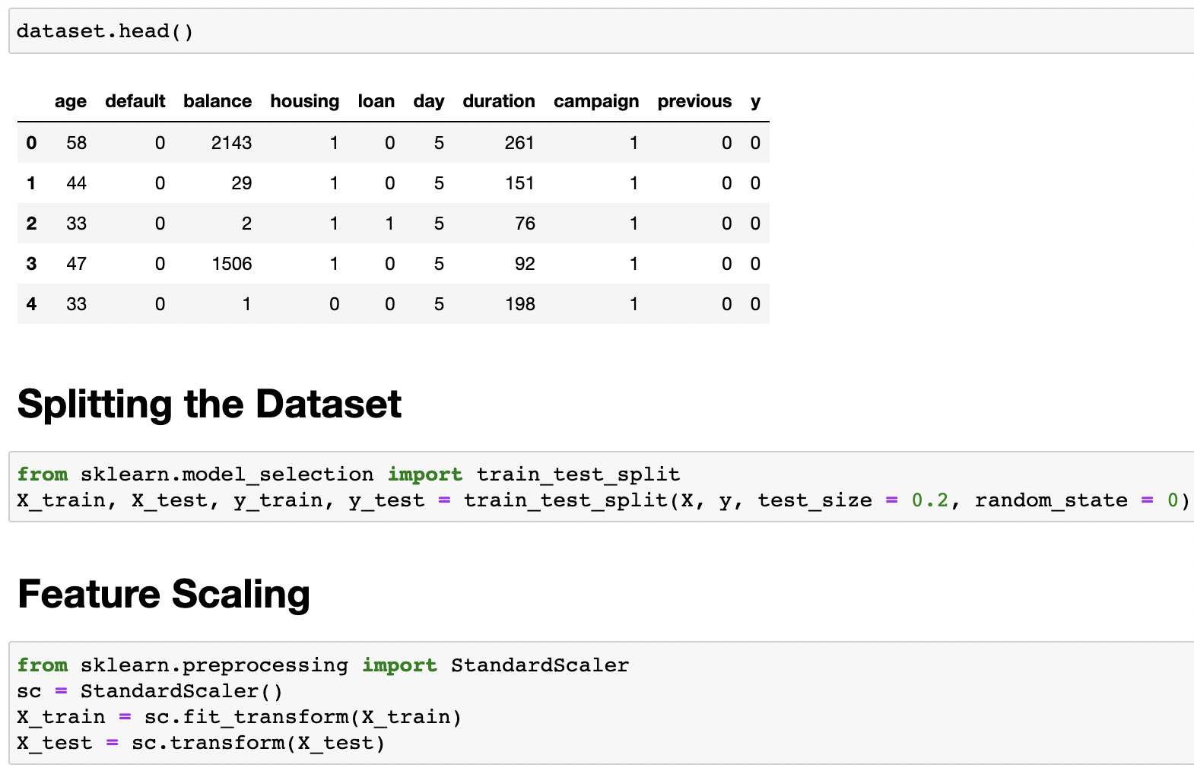
MACHINE LEARNING APPLICATION
15

Slide 17
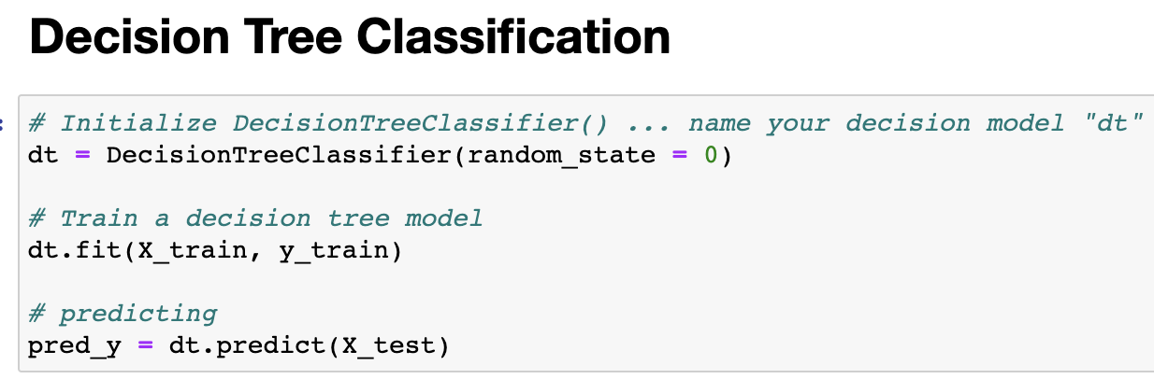
BASE MODEL
16

Slide 18
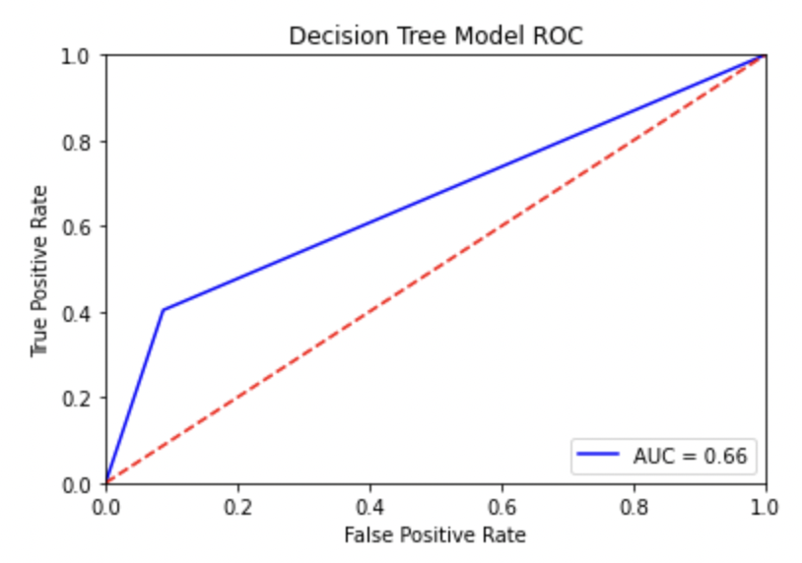
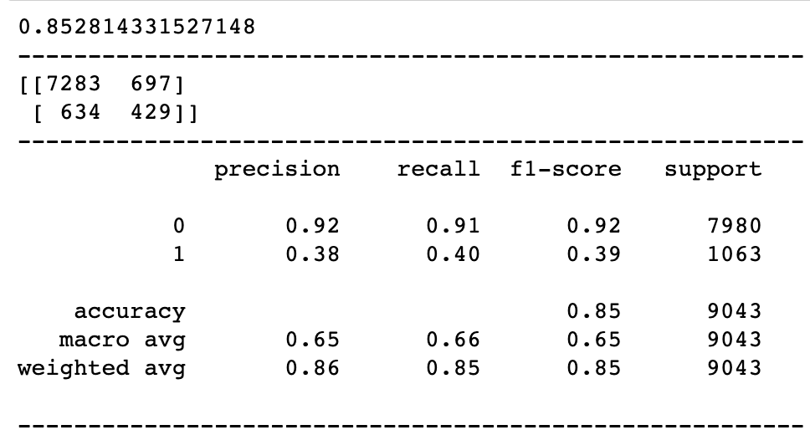
EVALUATION METRICS:
DECISION TREE CLASSIFICATION
17
Accuracy:
Fig 5:
Confusion Matrix

Slide 19
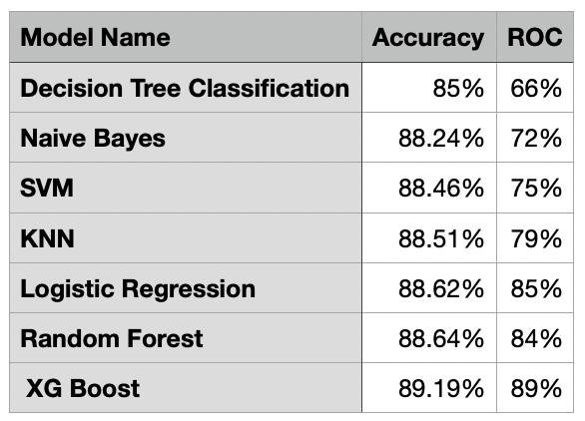
MODEL COMPARISION
18

Slide 20
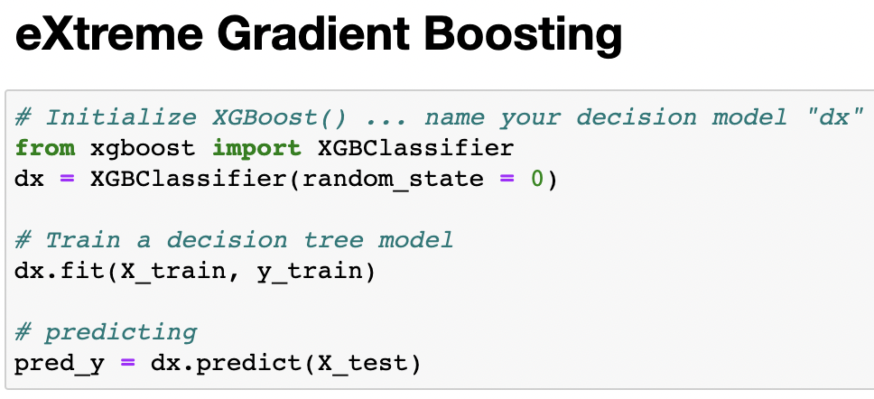
FINAL MODEL
19

Slide 21
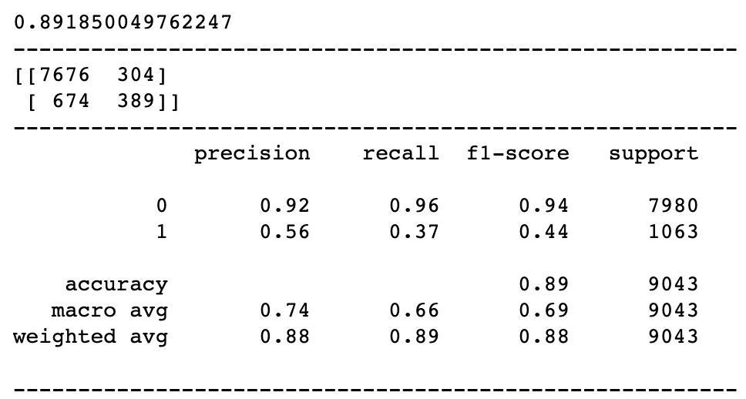
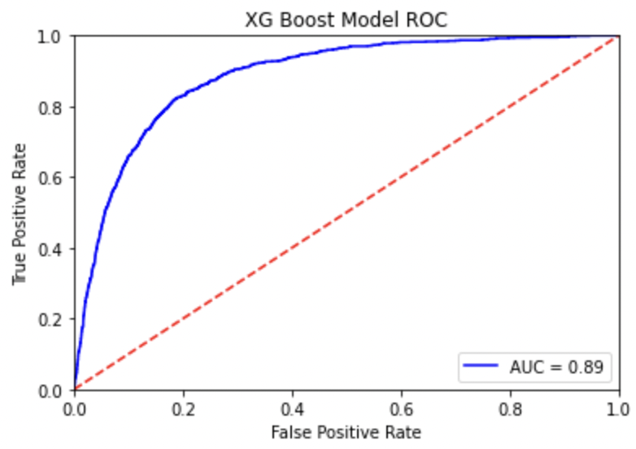
EVALUATION METRICS:
XG BOOST
20
Accuracy:
Fig 6:
Confusion Matrix

Slide 22
RESULT
21
Achieved Accuracy of 89% with XG Boost
Best ROC is 89%
4% increase of accuracy from the Base Model

Slide 23
FUTURE WORK
22
Try to increase model accuracy
Implementing same model using PyTorch
Applying the model for similar large dataset

Slide 24
REFERENCES
23
S. Moro, P. Cortez and P. Rita. A Data-Driven Approach to Predict the Success of Bank Telemarketing.
Decision Support Systems, Elsevier, 62:22-31, June 2014 S. Moro, R. Laureano and P. Cortez. Using Data Mining for Bank Direct Marketing: An Application of the CRISP-DM Methodology. In P. Novais et al. (Eds.), Proceedings of the European Simulation and Modelling Conference - ESM'2011, pp. 117-121, Guimaraes, Portugal, October, 2011. EUROSIS. [bank.zip]

Slide 25
REFERENCES
24
This dataset is public available for research. The details are described in [Moro et al., 2014]. [Moro et al., 2014] S. Moro, P. Cortez and P. Rita. A Data-Driven Approach to Predict the Success of Bank Telemarketing. Decision Support Systems, Elsevier, 62:22-31, June 2014

Slide 26
25
THANK YOU

